Slide 1

Essential Rhapsody in C++
Section 2
Basic Level
Bas-<number>
The Rhapsody in C++ Tool Training "Essential" © I-Logix 1999-2000 v2.3 25/9/2000

Slide 2
Section 2: Basic Level
Setting up Rhapsody in C++
Creating a project
Model / generate / make / run
Classes, attributes & operations
Simple statecharts
Simple sequence diagrams
Tracing
Animation
Use Case diagrams
Bas-<number>
The Rhapsody in C++ Tool Training "Essential" © I-Logix 1999-2000 v2.3 25/9/2000

Slide 3
Setting Up Rhapsody
Install Visual C++ 6.0
Install Rhapsody in C++ V2.3
Install license (License.dat)
Create a work directory ex: “D:\Rhapsody\Work”
Bas-<number>
The Rhapsody in C++ Tool Training "Essential" © I-Logix 1999-2000 v2.3 25/9/2000

Slide 4
Before We Start
Rhapsody uses C++ which is CASE sensitive. Most of the errors that occur during the training are generally due to entering text incorrectly.
During this training, all classes will start with an upper case ex: “Training”.
Often during the training course, students take differing lengths of time for completing the exercises. For those students who finish early, there is often an “Extended exercise”.
Bas-<number>
The Rhapsody in C++ Tool Training "Essential" © I-Logix 1999-2000 v2.3 25/9/2000

Slide 5
C++ Refresher
The following concepts (possibly unfamiliar to C users) will be used during the training:
  Constructor
  Constructor initializer
  Operator overloading
  Destructor
  New & Delete
  Inheritance
  Virtual operations
Bas-<number>
The Rhapsody in C++ Tool Training "Essential" © I-Logix 1999-2000 v2.3 25/9/2000

Slide 6
Section 2
Basic level
Hello World
Bas-<number>
The Rhapsody in C++ Tool Training "Essential" © I-Logix 1999-2000 v2.3 25/9/2000

Slide 7
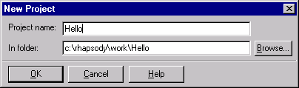
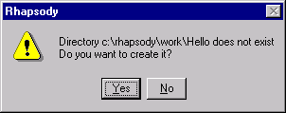
Creating a Project
Start up Rhapsody in C++ (development edition)
Within Rhapsody, create a new project Hello in c:\Rhapsody\work ( File->New ) or
Click Yes to create project.
Bas-<number>
The Rhapsody in C++ Tool Training "Essential" © I-Logix 1999-2000 v2.3 25/9/2000

Slide 8
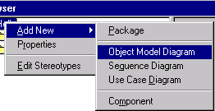

The Browser
The browser showing everything in the model is automatically started on opening a project.
In the browser right-click on the Hello folder and select “Add New > Object Model Diagram”
An alternative way of creating a new OMD is to use this tool bar.
Bas-<number>
The Rhapsody in C++ Tool Training "Essential" © I-Logix 1999-2000 v2.3 25/9/2000

Slide 9
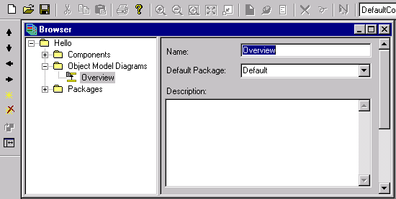
Renaming a Diagram
In the name field enter Overview as the name of the OMD (Object Model Diagram)
Use the enter or apply key to validate the name
Bas-<number>
The Rhapsody in C++ Tool Training "Essential" © I-Logix 1999-2000 v2.3 25/9/2000

Slide 10
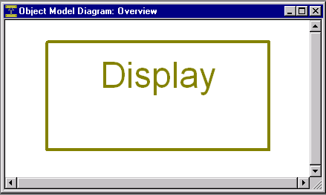
Drawing a Class
Double-click on the OMD “Overview” to open the OMD.
In this OMD, use the class icon to draw a class named Display.
There are two ways of deleting a class. It can be deleted from just the view “Remove from view” or deleted from the entire model “Delete from model”.
Bas-<number>
The Rhapsody in C++ Tool Training "Essential" © I-Logix 1999-2000 v2.3 25/9/2000

Slide 11
Creating an Operation
Display the features for the class Display by double-clicking on the class (or right-clicking and selecting features).
Select the operations tab and select new
Set the operation type to Constructor
Enter the following in the implementation field: cout << "Hello world" << endl;
Click or apply .
An operation can also be entered from the browser.
Make sure that you enter the code in the implementation field and not the description field.
Bas-<number>
The Rhapsody in C++ Tool Training "Essential" © I-Logix 1999-2000 v2.3 25/9/2000

Slide 12
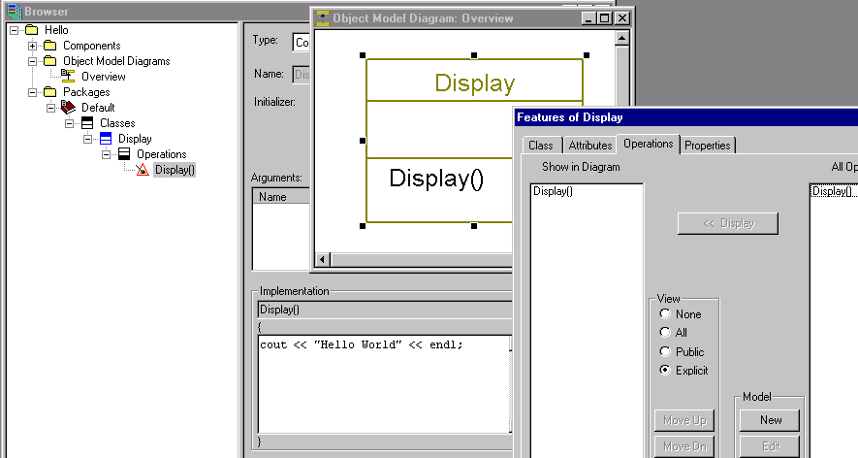
Creating an Operation
constructor
Operations
can be optionally displayed
on diagram
implementation
Bas-<number>
The Rhapsody in C++ Tool Training "Essential" © I-Logix 1999-2000 v2.3 25/9/2000

Slide 13
Creating a Component
In order to generate code, we must first create a component.
Rename the existing component DefaultComponent to Test:
Check that the component generates an “Executable” and that code will be generated from “All Elements”.
Bas-<number>
The Rhapsody in C++ Tool Training "Essential" © I-Logix 1999-2000 v2.3 25/9/2000

Slide 14
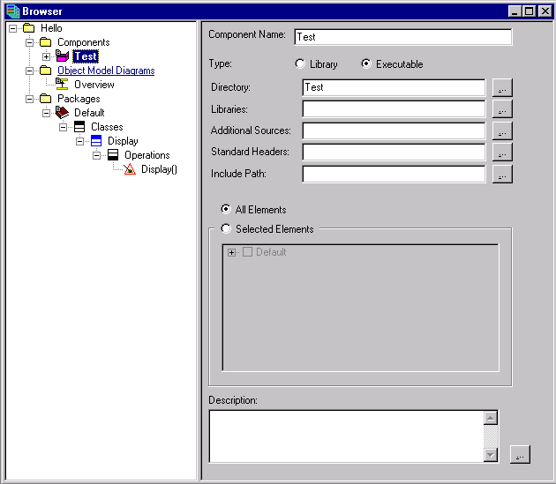
The Test Component
Name : Test
Generate an
executable
Generate code
for all elements
Description of component
Bas-<number>
The Rhapsody in C++ Tool Training "Essential" © I-Logix 1999-2000 v2.3 25/9/2000

Slide 15
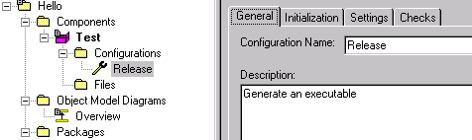
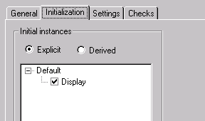
Creating a Configuration
Rename the configuration from “DefaultConfig” to “Release”
Select the Initialization tab and expand the default package and select the Display class, to create an initial instance of the Display class.
Bas-<number>
The Rhapsody in C++ Tool Training "Essential" © I-Logix 1999-2000 v2.3 25/9/2000

Slide 16

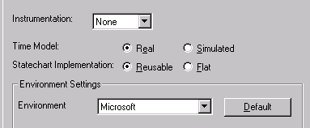
Selecting the Environment
Select the Settings tab and
  Check that the environment is set to Microsoft
  Check also that Instrumentation is set to None
The Microsoft environment implies that the code will be generated for the Windows 32bit OS and compiled using Visual C++.
Bas-<number>
The Rhapsody in C++ Tool Training "Essential" © I-Logix 1999-2000 v2.3 25/9/2000

Slide 17
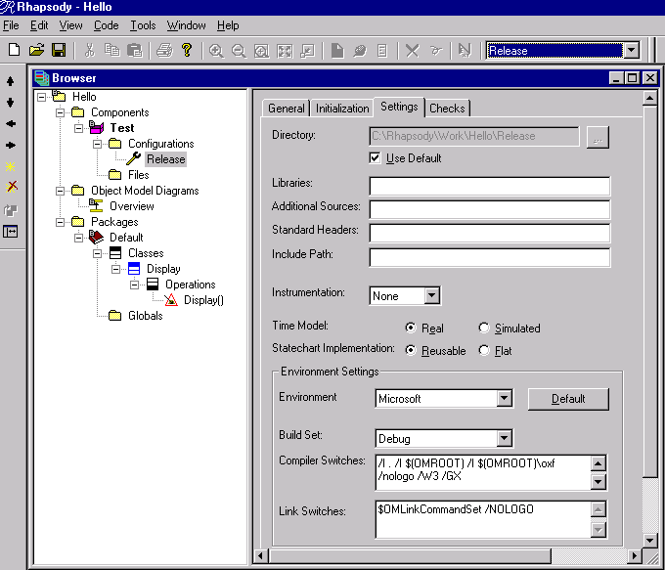
Selecting a Configuration
Current
configuration
Instrumentation
Environment
Bas-<number>
The Rhapsody in C++ Tool Training "Essential" © I-Logix 1999-2000 v2.3 25/9/2000

Slide 18
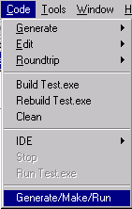

Generating Code
Save the model ( File->save ) or then
  Code -> Generate -> Release
  Code -> Build Test.exe
  Code -> Run Test.exe
or Generate/Make/Run
To access the code toolbar use View->Code Toolbar
Bas-<number>
The Rhapsody in C++ Tool Training "Essential" © I-Logix 1999-2000 v2.3 25/9/2000

Slide 19
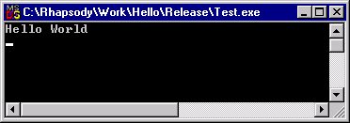
Hello World
You should see the following:
If during compilation, there is a problem, then simply double-click on the error to go directly to the diagram where the error occurred.
To exit, click the x. In Windows ‘95, this results in a error message.
Bas-<number>
The Rhapsody in C++ Tool Training "Essential" © I-Logix 1999-2000 v2.3 25/9/2000

Slide 20
Examining Code
Examine the files in C:\Rhapsody\work\Hello\Test\Release
  MainTest.cpp
  Test.mak
  Display.cpp
  Display.h
Setting the Windows registry so that .cpp and .h files are opened by notepad or another text editor rather than the Microsoft Developer studio can save time.
Bas-<number>
The Rhapsody in C++ Tool Training "Essential" © I-Logix 1999-2000 v2.3 25/9/2000

Slide 21
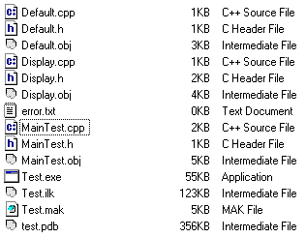
Generated Files
Default
Package files
main
Make file
Display class
executable
Bas-<number>
The Rhapsody in C++ Tool Training "Essential" © I-Logix 1999-2000 v2.3 25/9/2000

Slide 22
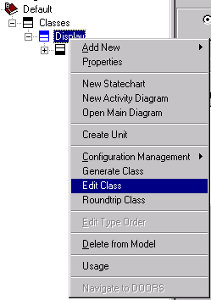
Editing the Code
Select the class Display in the browser by expanding the package Default .
Right click and select Edit Class
In the Display.cpp file:
change:
  cout << “Hello World” << endl;
to:
  cout << “Constructed” << endl;
Save and exit editor
Bas-<number>
The Rhapsody in C++ Tool Training "Essential" © I-Logix 1999-2000 v2.3 25/9/2000

Slide 23
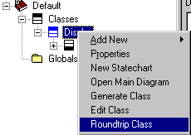
Roundtripping
The modifications in the Display.cpp file can be brought back into the model (to keep code and model synchronized) by roundtripping.
Select the Display class in the browser, right click and select Roundtrip Class.
Examine the implementation of the Display class constructor in the browser.
Presently, roundtripping can only be done within the delimiters. Note that if having modified the code, we generate code without roundtripping, then Rhapsody will ask us if we want to roundtrip.
Bas-<number>
The Rhapsody in C++ Tool Training "Essential" © I-Logix 1999-2000 v2.3 25/9/2000

Slide 24
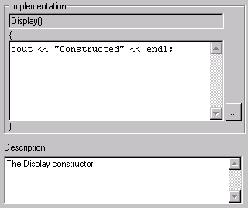
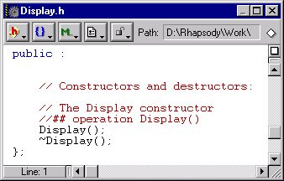
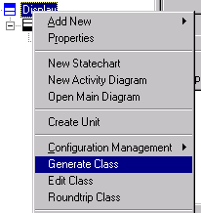
Extended Exercise
Add a description to the Display constructor
Regenerate code just for the Display class
Note that the description appears in the code
Bas-<number>
The Rhapsody in C++ Tool Training "Essential" © I-Logix 1999-2000 v2.3 25/9/2000

Slide 25
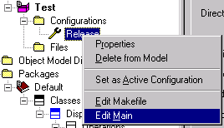
Displaying the Main and Make
The main and make can be displayed from within Rhapsody by right-clicking on the configuration:
Bas-<number>
The Rhapsody in C++ Tool Training "Essential" © I-Logix 1999-2000 v2.3 25/9/2000

Slide 26
Section 2
Basic Level
Count Down
Bas-<number>
The Rhapsody in C++ Tool Training "Essential" © I-Logix 1999-2000 v2.3 25/9/2000

Slide 27

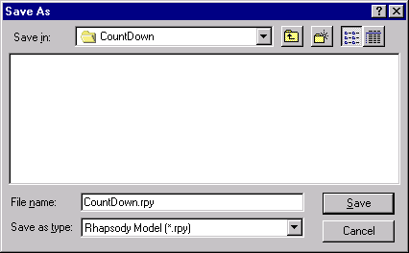
Copying a Project
Select File -> Save As
Press to select the Work folder
Press to create a new folder
Rename “new folder” to “CountDown”
Save the project as CountDown.rpy
Exit Rhapsody
Bas-<number>
The Rhapsody in C++ Tool Training "Essential" © I-Logix 1999-2000 v2.3 25/9/2000

Slide 28
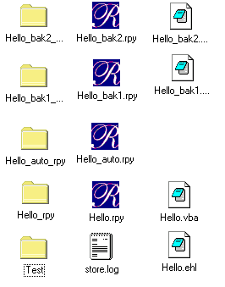
Project Files
Previous backup
Last backup
AutoSave
Latest version
Event History Log
Generated files for the test component
Bas-<number>
The Rhapsody in C++ Tool Training "Essential" © I-Logix 1999-2000 v2.3 25/9/2000

Slide 29
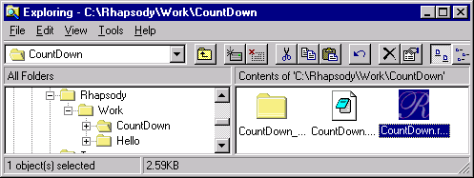
Loading the CountDown Project
Either start Rhapsody and file -> open
Or double click on the CountDown.rpy file
Note that although multiple copies of Rhapsody can be opened simultaneously, animation is only possible with the first copy opened.
The Rhapsody.ini file determines which Rhapsody ( C/C++/J ) is opened on double-clicking the .rpy file
Bas-<number>
The Rhapsody in C++ Tool Training "Essential" © I-Logix 1999-2000 v2.3 25/9/2000

Slide 30
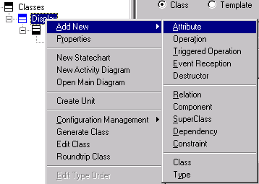
Adding an Attribute
To add an attribute right-click on the Display class and select “Add New > Attribute”
Bas-<number>
The Rhapsody in C++ Tool Training "Essential" © I-Logix 1999-2000 v2.3 25/9/2000

Slide 31
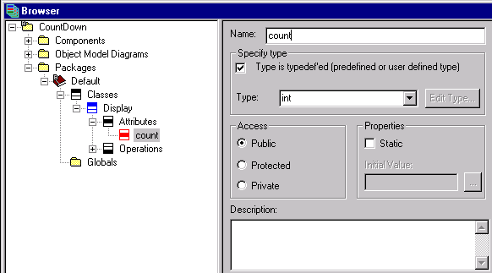
Attribute Count
Rename the attribute “count”.
Check that the attribute is an int
Bas-<number>
The Rhapsody in C++ Tool Training "Essential" © I-Logix 1999-2000 v2.3 25/9/2000

Slide 32
Accessors and Mutators
Save / Generate / Make
Edit the Display.cpp file
Note the accessor getCount()
and the mutator setCount(int)
int Display::getCount() const {
return count;
};
void Display::setCount(int p_count) {
count = p_count;
};
By default, all attributes are protected, setting the access actually sets the access of the mutator / accessor.
Bas-<number>
The Rhapsody in C++ Tool Training "Essential" © I-Logix 1999-2000 v2.3 25/9/2000

Slide 33
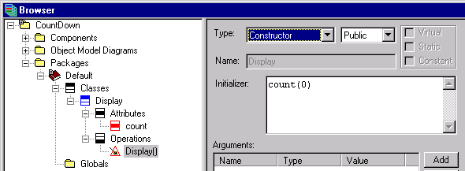
Attribute Initializing
Initialize the attribute to 0 by setting the initializer field of the constructor to count(0)
This is the standard C++ way of initializing attributes.
Bas-<number>
The Rhapsody in C++ Tool Training "Essential" © I-Logix 1999-2000 v2.3 25/9/2000

Slide 34
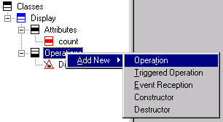
Adding an Operation
Right-click on the Display class or on Operations and select “Add New > Operation”
Bas-<number>
The Rhapsody in C++ Tool Training "Essential" © I-Logix 1999-2000 v2.3 25/9/2000

Slide 35
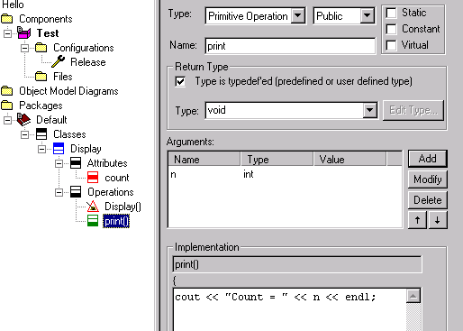
Adding a print(int n) Operation
Name the operation print
Add an argument n of type int
Add implementation:
cout << “Count = “ << n << endl;
Bas-<number>
The Rhapsody in C++ Tool Training "Essential" © I-Logix 1999-2000 v2.3 25/9/2000

Slide 36
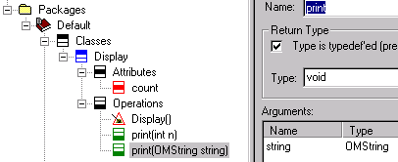
Operation Overloading
Add another operation print
Add argument string of type OMString
Add body: cout << string << endl;
OMString is a Rhapsody string class, for the time being we’ll just use it. A more detailed explanation follows in a later section.
Bas-<number>
The Rhapsody in C++ Tool Training "Essential" © I-Logix 1999-2000 v2.3 25/9/2000

Slide 37
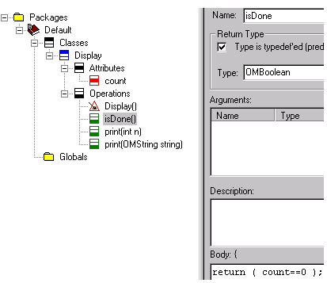
Operation isDone()
In the same way add another operation isDone
Set return type OMBoolean
Add implementation: return (count==0);
Bas-<number>
The Rhapsody in C++ Tool Training "Essential" © I-Logix 1999-2000 v2.3 25/9/2000

Slide 38
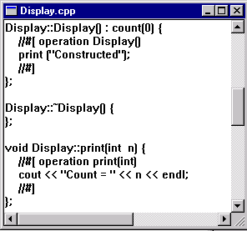
Using the print() Operation
Replace body of Display constructor with print (“Constructed”);
Save / Generate / Make / Run
Examine code
initializer
Bas-<number>
The Rhapsody in C++ Tool Training "Essential" © I-Logix 1999-2000 v2.3 25/9/2000

Slide 39
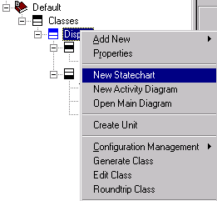
Adding a Statechart
Right-click on the Display class to create a “New Statechart” for the Display class
Bas-<number>
The Rhapsody in C++ Tool Training "Essential" © I-Logix 1999-2000 v2.3 25/9/2000

Slide 40
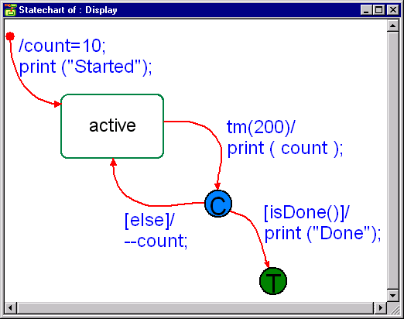
Simple Statechart
Draw the following statechart:
Rhapsody
timeout
operation
actions
Conditional
connector
Default
transition
state
terminator
transition
guards
Bas-<number>
The Rhapsody in C++ Tool Training "Essential" © I-Logix 1999-2000 v2.3 25/9/2000

Slide 41
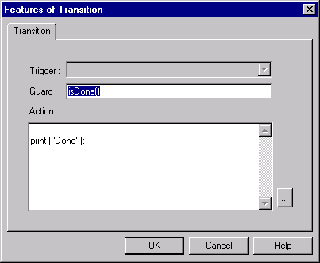
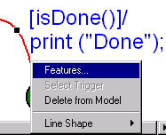
Transitions
Once a transition has been drawn on a statechart, there are two ways to enter information.
In text format ex: [isDone()]/print ("Done");
By the features of the transition (activated by double-clicking or right-clicking on the transition)
Empty line forces the action to appear on a new line
Bas-<number>
The Rhapsody in C++ Tool Training "Essential" © I-Logix 1999-2000 v2.3 25/9/2000

Slide 42
The Timer Mechanism
Rhapsody provides a timer that can be used within the statecharts
tm(200) acts as an event that will be taken 200ms after the state is entered
On entering a state the timer is started and stopped on exiting
The timer uses the OS tick and so will only generate timeouts that are a multiple of ticks.
Bas-<number>
The Rhapsody in C++ Tool Training "Essential" © I-Logix 1999-2000 v2.3 25/9/2000

Slide 43
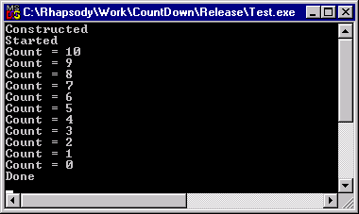
Statechart Code
Save / Generate / Make / Run
constructor
Default transition
Bas-<number>
The Rhapsody in C++ Tool Training "Essential" © I-Logix 1999-2000 v2.3 25/9/2000

Slide 44
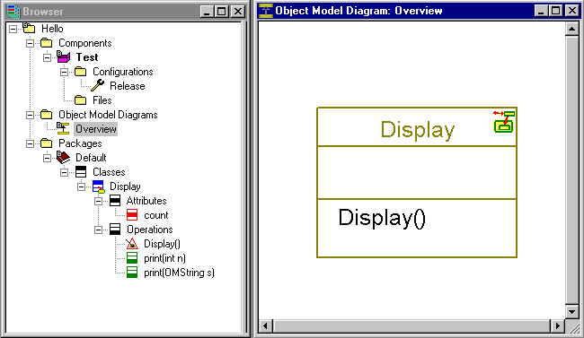
Statechart Symbol
Now that the Display class is “Reactive” it has a special symbol in both the browser and the OMD.
Bas-<number>
The Rhapsody in C++ Tool Training "Essential" © I-Logix 1999-2000 v2.3 25/9/2000

Slide 45
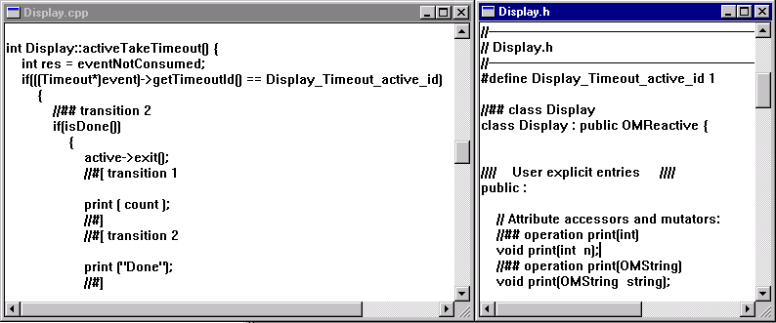
Generated Code
Edit and examine the code for the Display class
Note that the Display class inherits from OMReactive, one of Rhapsody’s framework base classes.
Bas-<number>
The Rhapsody in C++ Tool Training "Essential" © I-Logix 1999-2000 v2.3 25/9/2000

Slide 46

Statechart Implementation
Set statechart implementation from Reusable to Flat in the configuration settings
Save / Generate / Examine code
The Rhapsody framework allows two ways of implementing statecharts:
Reusable which is based on the state design pattern where each state is an object. Results in faster execution and if a lot of statecharts are inherited can result in smaller code.
Flat which uses a switch statement. Results in less code that is easier to read, but is slower.
Bas-<number>
The Rhapsody in C++ Tool Training "Essential" © I-Logix 1999-2000 v2.3 25/9/2000

Slide 47
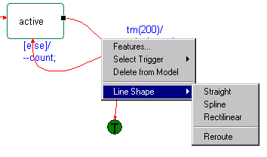
Extended Exercise
Experiment with the line shape of transitions.
Bas-<number>
The Rhapsody in C++ Tool Training "Essential" © I-Logix 1999-2000 v2.3 25/9/2000

Slide 48
Section 2
Basic level
Tracing
Bas-<number>
The Rhapsody in C++ Tool Training "Essential" © I-Logix 1999-2000 v2.3 25/9/2000

Slide 49
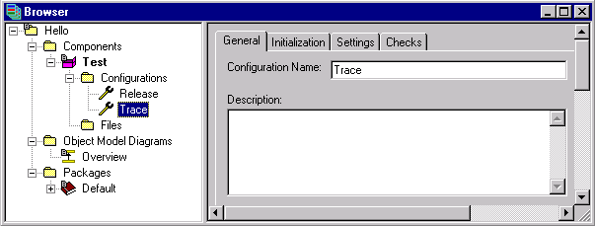
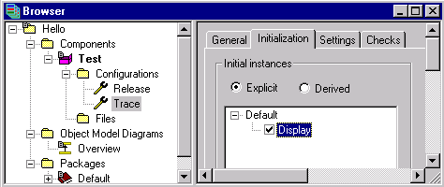
New Configuration for Tracing
Create a new configuration Trace
Create an initial instance of Display
Bas-<number>
The Rhapsody in C++ Tool Training "Essential" © I-Logix 1999-2000 v2.3 25/9/2000

Slide 50
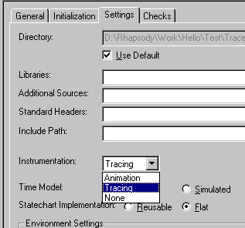
Tracing Settings
In the settings set the instrumentation to Tracing
Bas-<number>
The Rhapsody in C++ Tool Training "Essential" © I-Logix 1999-2000 v2.3 25/9/2000

Slide 51

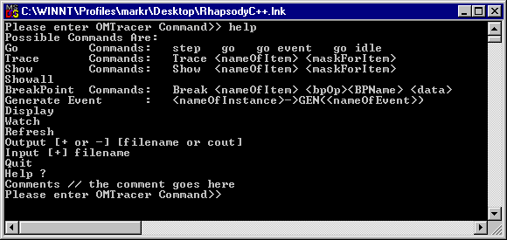
Executing in Tracing Mode
Select the Trace configuration
Save / Generate / Make / Run
When the DOS Console window appears type help
Bas-<number>
The Rhapsody in C++ Tool Training "Essential" © I-Logix 1999-2000 v2.3 25/9/2000

Slide 52
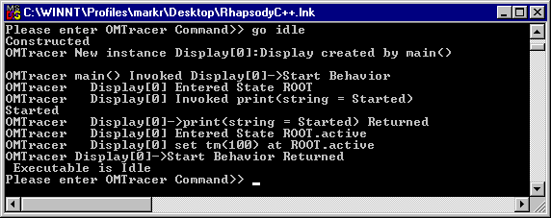
Tracing Step by Step
The tracing mode can be used to control and to capture what happens during execution.
Type go idle to start the execution
Bas-<number>
The Rhapsody in C++ Tool Training "Essential" © I-Logix 1999-2000 v2.3 25/9/2000

Slide 53
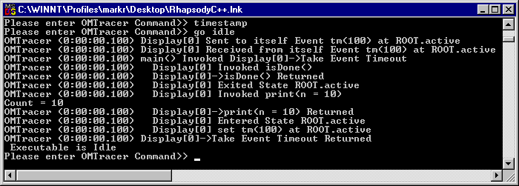
Time Stamping
Type timestamp to switch on the time stamping
Type go idle
At the moment this command only works in the tracing mode and not in the animation mode. “timestamp-” turns off the time stamping. “timestamp+raw” displays the time in an unsigned format.
Bas-<number>
The Rhapsody in C++ Tool Training "Essential" © I-Logix 1999-2000 v2.3 25/9/2000

Slide 54
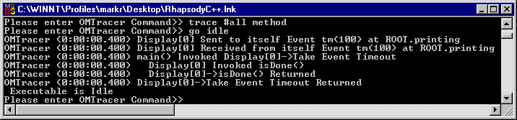
Tracing the Methods
Type trace #all method to trace just the executed methods
Type go idle
By default Rhapsody traces everything. This is the same as the command trace #all all.
Bas-<number>
The Rhapsody in C++ Tool Training "Essential" © I-Logix 1999-2000 v2.3 25/9/2000

Slide 55
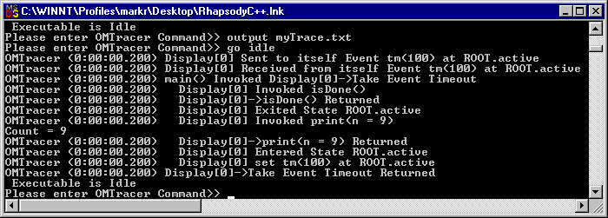
Capturing the Trace
Type output myTrace.txt
Type go idle
Type go
Exit the DOS console window
Bas-<number>
The Rhapsody in C++ Tool Training "Essential" © I-Logix 1999-2000 v2.3 25/9/2000

Slide 56
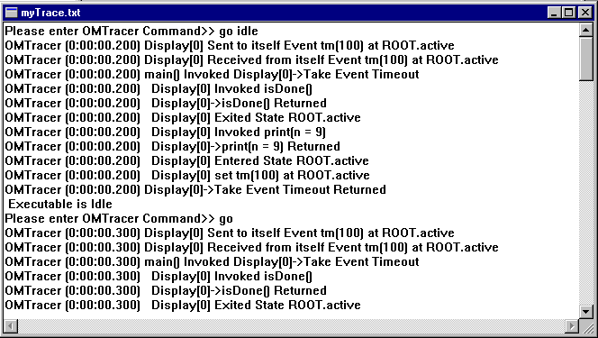
Examining the Trace
Edit the generated trace file myTrace.txt
Note that the isDone() operation is invoked before the print() operation.
Bas-<number>
The Rhapsody in C++ Tool Training "Essential" © I-Logix 1999-2000 v2.3 25/9/2000

Slide 57
Extended Exercise
Rerun Test.exe and experiment with other trace commands such as:
show Display[0] attributes
break Display[0] attribute[count]
...
More detailed help about the trace mode can be found in the reference guide.
The trace is useful for doing regression tests and for debugging purposes.
Bas-<number>
The Rhapsody in C++ Tool Training "Essential" © I-Logix 1999-2000 v2.3 25/9/2000

Slide 58
Section 2
Basic level
Animation
Bas-<number>
The Rhapsody in C++ Tool Training "Essential" © I-Logix 1999-2000 v2.3 25/9/2000

Slide 59
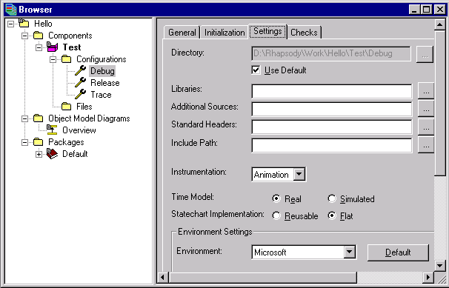
Animation
Create a new configuration Debug
Create initial instance of Display
Set the instrumentation to Animation
Save / Generate / Make / Run
Bas-<number>
The Rhapsody in C++ Tool Training "Essential" © I-Logix 1999-2000 v2.3 25/9/2000

Slide 60
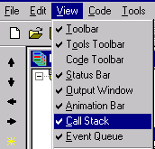

Call Stack & Event Queue
Open the call stack “View->Call Stack”, this window shows the operations being executed on the current thread.
Open the event queue “View->Event Queue” this window shows the pending events for the current thread.
It might be necessary to deplace the bar above the call stack / event queue and output window to tile these windows.
Bas-<number>
The Rhapsody in C++ Tool Training "Essential" © I-Logix 1999-2000 v2.3 25/9/2000

Slide 61

Animation Tool Bar
go step
go
go idle
go event
animation break
command prompt
quit animation
threads
breakpoints
events generator
watch/ display continuous update
When grayed out indicates a
singled-threaded application
Bas-<number>
The Rhapsody in C++ Tool Training "Essential" © I-Logix 1999-2000 v2.3 25/9/2000

Slide 62


Starting the Animation
go step
Note that the Display constructor appears in the call stack
Continue to go step until the “Executable is Idle” message appears in the output window
Title only appears when window is undocked.
Bas-<number>
The Rhapsody in C++ Tool Training "Essential" © I-Logix 1999-2000 v2.3 25/9/2000

Slide 63

Animated Browser
In the browser, note that there is now an instance of the Display class
Note that the count for this instance = 10
Bas-<number>
The Rhapsody in C++ Tool Training "Essential" © I-Logix 1999-2000 v2.3 25/9/2000

Slide 64



Animated Statechart
Right click on the instance to “Open instance statechart”
Highlighted state
Bas-<number>
The Rhapsody in C++ Tool Training "Essential" © I-Logix 1999-2000 v2.3 25/9/2000

Slide 65

Animating
Repeatedly do go idle or go and watch the animation until the instance is destroyed.
Note that the value of the count attribute changes.
Note that the transition taken is also highlighted
Bas-<number>
The Rhapsody in C++ Tool Training "Essential" © I-Logix 1999-2000 v2.3 25/9/2000

Slide 66


Destructor
Exit the animation and add a destructor
set the body to print(“Destroyed”);
Save / Generate / Make / Run
Don’t enter the code into the description instead of the implementation!
Bas-<number>
The Rhapsody in C++ Tool Training "Essential" © I-Logix 1999-2000 v2.3 25/9/2000

Slide 67


Sequence Diagrams
From the browser, select the Default package and create a new sequence diagram called “What we expect to happen”
Bas-<number>
The Rhapsody in C++ Tool Training "Essential" © I-Logix 1999-2000 v2.3 25/9/2000

Slide 68

Dragging From the Browser
Put the browser on the left and shrink it using the shrink/expand icon
Double-click on the sequence diagram to open it.
Select the Display class and drag and drop it onto the Sequence Diagram.
Bas-<number>
The Rhapsody in C++ Tool Training "Essential" © I-Logix 1999-2000 v2.3 25/9/2000

Slide 69

Drawing a Sequence Diagram
Add a system border, a constructor and a few messages and timeouts.
Bas-<number>
The Rhapsody in C++ Tool Training "Essential" © I-Logix 1999-2000 v2.3 25/9/2000

Slide 70


Drawing Messages
Messages can be added to sequence diagrams using the icon. Once entered, Rhapsody will add a new message ex: Message_8.
This can either be accepted, in which case the message will be added to the class, or by right-clicking, another operation can be selected.
Bas-<number>
The Rhapsody in C++ Tool Training "Essential" © I-Logix 1999-2000 v2.3 25/9/2000

Slide 71

Animated Sequence Diagrams
Start the animation, this will create an animated sequence diagram.
Note that the animated Sequence Diagram captures what happens.
Bas-<number>
The Rhapsody in C++ Tool Training "Essential" © I-Logix 1999-2000 v2.3 25/9/2000

Slide 72

Extended Exercise
Modify the statechart as shown:
Save / Generate / Make / Run
Bas-<number>
The Rhapsody in C++ Tool Training "Essential" © I-Logix 1999-2000 v2.3 25/9/2000

Slide 73
Section 2
Basic level
Properties
Bas-<number>
The Rhapsody in C++ Tool Training "Essential" © I-Logix 1999-2000 v2.3 25/9/2000

Slide 74
Properties
Rhapsody has many properties that allow customization of the tool and the generated code.
Properties can be set once and for all by modifying the site.prp file in the “Rhapsody\share\properties” directory
The Factory.prp and FactoryC++.prp files contain all the Rhapsody properties
Custom Properties can also be added to the site.prp (see “Using the API” in the specialist section)
It is recommended to modify the site.prp file rather than the factory.prp and factoryC++.prp files. To do so it is easiest to copy and paste from these files into the site.prp file.
Bas-<number>
The Rhapsody in C++ Tool Training "Essential" © I-Logix 1999-2000 v2.3 25/9/2000

Slide 75
Property Inheritance
Factory.prp
FactoryC++.prp
Site.prp
component
project
configuration
package
relation
operation
attribute
Class
Bas-<number>
The Rhapsody in C++ Tool Training "Essential" © I-Logix 1999-2000 v2.3 25/9/2000

Slide 76


Project Properties
Bring up the project properties under File
Bas-<number>
The Rhapsody in C++ Tool Training "Essential" © I-Logix 1999-2000 v2.3 25/9/2000

Slide 77


Project Properties : ClassCodeEditor
When editing .cpp and .h files, Rhapsody uses its internal editor. To use the same editor as is setup in the registry for these files, double-click on the property ClassCodeEditor and select Associate.
Note the x indicating that the property has been overloaded.
Bas-<number>
The Rhapsody in C++ Tool Training "Essential" © I-Logix 1999-2000 v2.3 25/9/2000

Slide 78


Properties for Attributes
Bring up the properties for the count attribute by right-clicking on count in the browser.
Set MutatorGenerate and AccessorGenerate to False.
Generate and examine code.
Bas-<number>
The Rhapsody in C++ Tool Training "Essential" © I-Logix 1999-2000 v2.3 25/9/2000

Slide 79



Properties for Operations
Bring up the properties for the operation isDone()
Set inline to in_header
Generate code and check that isDone() is inline.
Bas-<number>
The Rhapsody in C++ Tool Training "Essential" © I-Logix 1999-2000 v2.3 25/9/2000

Slide 80

Site.prp
Setting associate class code editor
Setting up Doors as RT tool
& PVCS as CM tool
Adding custom environments
Bas-<number>
The Rhapsody in C++ Tool Training "Essential" © I-Logix 1999-2000 v2.3 25/9/2000

Slide 81
Section 2
Basic level
Use Case Diagrams
Bas-<number>
The Rhapsody in C++ Tool Training "Essential" © I-Logix 1999-2000 v2.3 25/9/2000

Slide 82


Use Case Diagrams
Add a use case diagram called “main use” and add an actor user and a use case count down
Bas-<number>
The Rhapsody in C++ Tool Training "Essential" © I-Logix 1999-2000 v2.3 25/9/2000

Slide 83

Adding a Description to the Use Case
Double-click on the use case count down to add a description.
Bas-<number>
The Rhapsody in C++ Tool Training "Essential" © I-Logix 1999-2000 v2.3 25/9/2000

Slide 84

Adding Scenarios to Use Cases
For the use case “count down”, select “Add New Referenced Sequence Diagram”
Bas-<number>
The Rhapsody in C++ Tool Training "Essential" © I-Logix 1999-2000 v2.3 25/9/2000

Slide 85


Referenced Sequence Diagrams
Select the sequence diagram “What we expect to happen”
Bas-<number>
The Rhapsody in C++ Tool Training "Essential" © I-Logix 1999-2000 v2.3 25/9/2000

Slide 86

Bas-<number>
The Rhapsody in C++ Tool Training "Essential" © I-Logix 1999-2000 v2.3 25/9/2000

